Slide 1
The Cause and Resolution of Conflict
U P F

Slide 2
Understanding the Root Cause of Conflict

Slide 3
Peace – Living for the sake of others
Living for the sake of others – pair system
I exist to benefit the whole – higher purpose
The Individual
Lives for the Whole
Individual
Whole
The Whole supports
the Individual

Slide 4
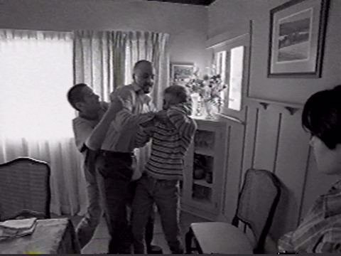
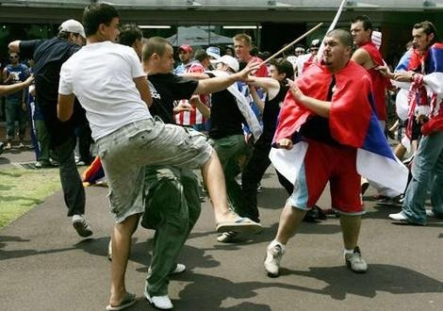
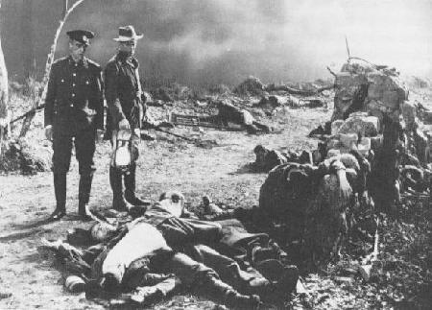
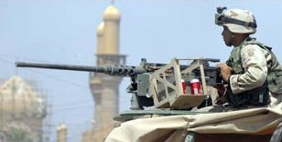
Reality is tragically different – a world of conflict

Slide 5
The Cause of Conflicts
‘Self’- centred, not higher purpose - centred
Others exist for my benefit
Diminish the value of the whole
Individual
Whole

Slide 6
The reality of Human Nature
Selfish Nature
Well-developed
Original
Nature
Undeveloped

Slide 7
The Conflicted Self
Whoever proclaims himself good , know, goodness approaches him not. Sikhism Adi Granth, Gauri Sukhmani 12
The mind is two-fold: the pure and also the impure. Hinduism, Maitri Upanishad 6.34
Every person has both a bad heart and good heart.
Native American Religions, Mohawk Tradition
I do not do the good that I want, but the evil I do not want is what I do.
Christianity, Romans 7.15

Slide 8
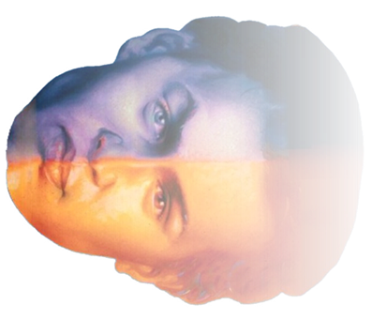
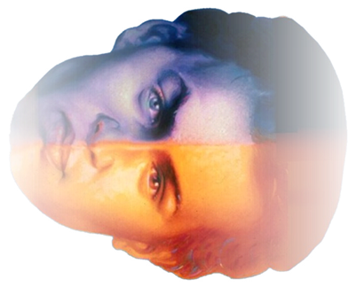
Our thoughts and actions determine our nature
Evil
Good
Evil or selfish thoughts, words
and actions
Immediate
‘body’ dominated
Unselfish thoughts, words
and actions
Eternal
Mind led
There is a battle in the mind of each person which
manifests as conflict in the family, society and world

Slide 9
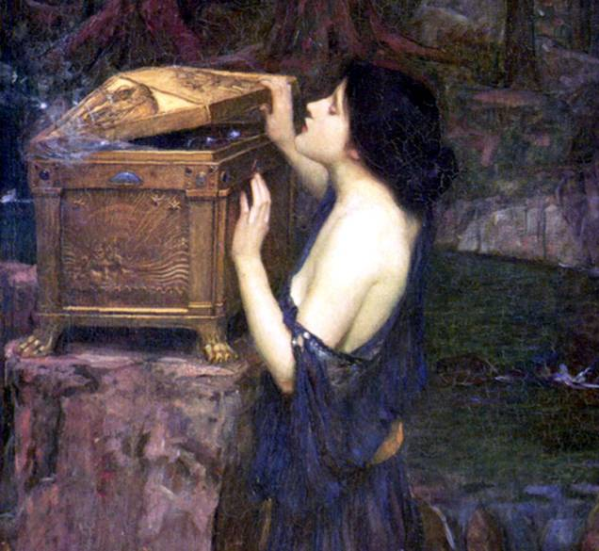
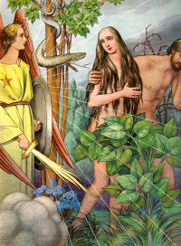
The Origin of Conflict – clues in traditional stories
Not intended as scientific history
Intuition about the human condition
Religious traditions believed to be revealed from a divine source
Notes:
Greek Mythology Pandora, the first woman, opened the jar and let out a multitude of plagues
Persian Scriptures The first man and woman, Meschia and Mieschiane, were seduced by Ahriman, in the form of a serpent, and commit the carnal sin which then taints their descendants
The Talmud What was the wicked serpent contemplating at that time? He thought, ‘I shall go and kill Adam and wed his wife, and I shall be king over the world.’
The Holy Qur’an O, Children of Adam! Let not Satan seduce you in the same manner as he got your parents out of the Garden, stripping them of their clothing in order to expose their private parts.

Slide 10
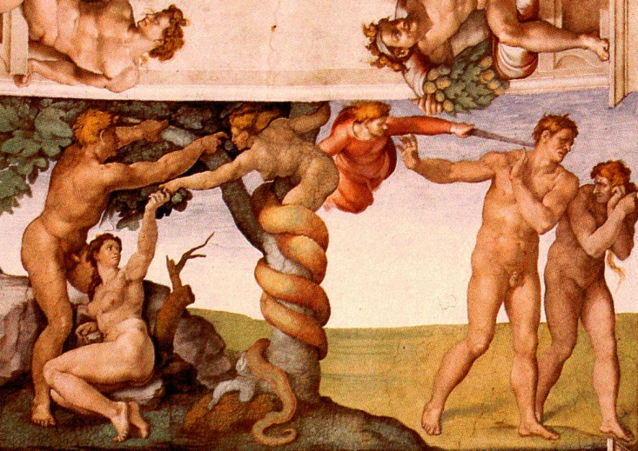
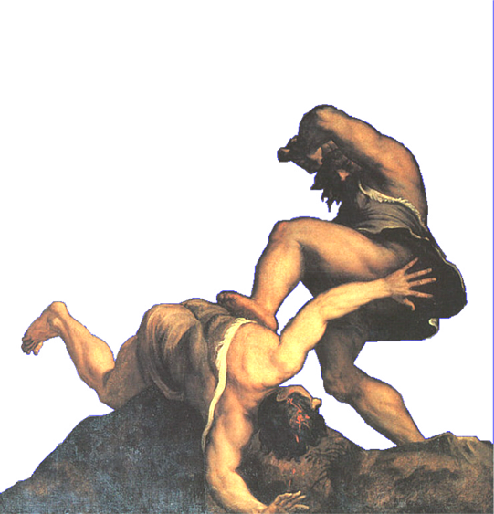
Conflict in the Family
Adam and Eve: illicit love
Cain and Abel: the first murder
Notes:
10
Eating the “fruit of knowledge of good and evil” was not merely eating a fruit.
Love became corrupted and misdirected within the relationship of Adam and Eve.
Afterwards, they covered their lower parts
One of their children murdered the other

Slide 11
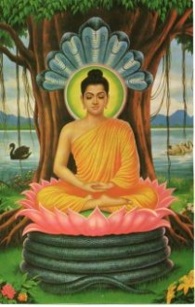
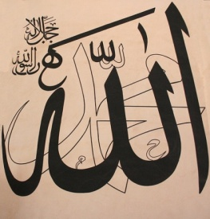
The impact of sexual immorality
It is better to die than to indulge in partaking of forbidden lustful pleasure. Uttarangasutram 22.42
The man who goes to the wife of another …digs up the very roots of life. Dhammapada 18.247
Do not come near adultery: for it is a shameful deed and evil, opening the road to other evils. Qur’an 17.32
Flee from sexual immorality. … he who sins sexually sins against his own body.
I Corinthians 6.18

Slide 12
Conflict in the Family
Evil,
selfish
purpose
False
Love
Self-centred
Man
Self-centred
Woman
False
Parents
Self-centred
Children
False Life
Selfish viewpoint
Irresponsible
Exploiting others
Multiplying Evil
Self-centred
Family & Society
False Lineage

Slide 13
The root cause of conflict
God
1) Separation from God
2) Individual-level Conflict
People
Mind
Body
(Spiritual)
(Physical)
Whole
Others
Self

Slide 14
The root cause of conflict
2) Individual-level Conflict
Mind
Body
3) Family-level Conflict
Husband
Wife
Brother
Brother

Slide 15
The expansion of conflict
3. Universal Conflict
2. Conflict in Human Society
Selfish
Purpose
1. Conflict within the Individual
Selfish
Purpose
Selfish
People
Environment
Selfish
Purpose
Husband
Wife
False
Ownership
Mind
Body
False
Lineage
Self-serving
Exploitative
Family Society
Nation
World
Selfish
Person

Slide 16
Restoring Peace and Happiness
Strengthening heart and conscience
Loving the enemy

Slide 17
Where does peace begin ?
Since wars begin in the minds of men, it is in the minds of men that the defenses of peace must be constructed.
UNESCO Constitution Preamble
17
Notes:
2015/11/25
17

Slide 18
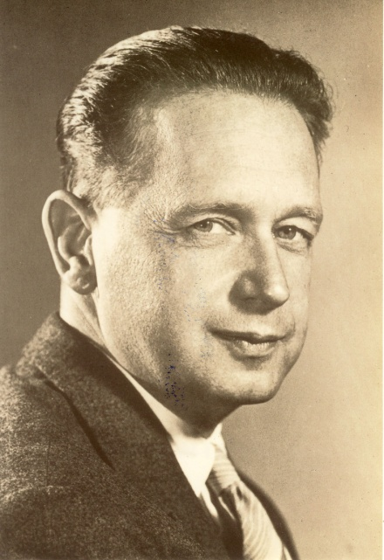
We need spiritual renewal
I see no hope for permanent world peace. We have tried and failed miserably. Unless the world has a spiritual rebirth, civilization is doomed.
Dag Hammarskjold
Second UN Secretary-General

Slide 19
Religion: a restorative vehicle
True religious practice seeks to restore
the original ideal of peace and promotes:
Humility in front of God, respect to parents, fidelity in marriage, loyalty, public service
Personal discipline, sacrifice and control of physical desires
Restraint, patience and forgiveness in relationships
Love others as you love yourself
Love of neighbours, and even enemies

Slide 20
How do we change our nature ?
Indemnity = Spiritual Restoration
Original
Position
An effort to reverse or restore something that was lost.
Taking responsibility by taking actions to correct flaws, weaknesses and bad habits
Lost
Restored
Current
Reality
Notes:
For example
honest person > lies > becomes a liar > change of heart > confesses > a period of honest conduct > recover status as an honest person in the eyes of others
Adulterer >>>>

Slide 21
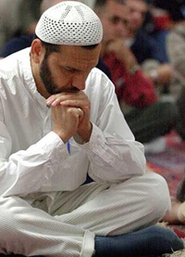
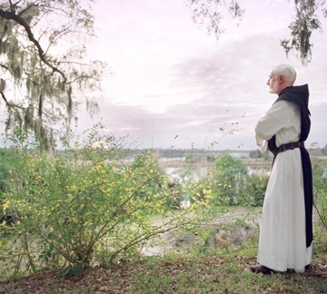
Step 1 : reconcile with God and higher values
Prayer and meditation
Offerings to God
Study of Scripture
Sexual purity, celibacy, separation from the world
Submission and obedience to God

Slide 22
Step 2 : reconcile with each other
Let evil be rewarded by like evil, but he who forgives and seeks reconciliation shall be rewarded by God. He does not love the wrongdoers …. True constancy lies in forgiveness and patient forbearance.
Islam Qur’an 42. 40-43
If you are offering your gift at the altar, and there remember that your brother has something against you, leave your gift there before the altar and go; first be reconciled to your brother, and then come and offer your gift.
Christianity
Matthew 5:23-24
Where there is forgiveness there is God Himself.
Sikhism Adi Granth, Shalok Kabir p 1372

Slide 23
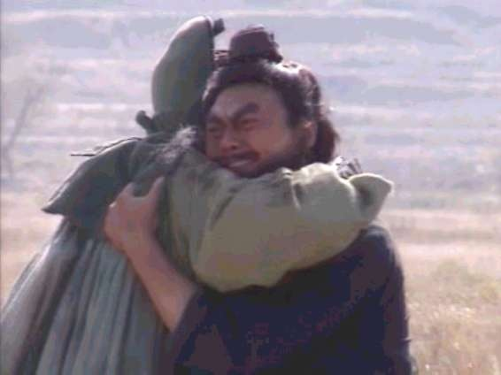
Honour God and higher values + Love each other
God’s Word
Higher Values
Learn, believe and practice
Practice in relationship with others.
+
Success in both areas is needed
to move closer to the goal of peace.

Slide 24
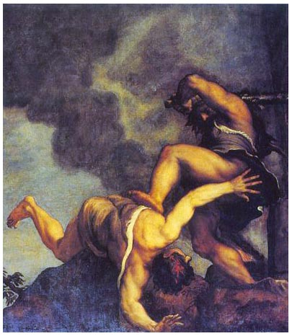
Archetypes of Conflict
God wanted Cain and Abel to love each other.
If you do what is right, will you not be accepted?
But if you do not do what is right, sin is crouching at your door . . . but you must master it.
Judaism: Genesis 4

Slide 25
Archetypes of Conflict
ABEL
CAIN
Abel loved God, but could not win the heart of his brother who was consumed with resentment .
Abel had God’s blessing and would not share it
Cain was consumed with resentment over perceived injustice, not seeing his brother from God’s point of view.
Unable to control his anger, he killed his brother

Slide 26
What should happen
ABEL
CAIN
Be humble even though blessed by God.
Forgive and be tolerant in the face of abuse.
Serve his brother to melt his resentment.
Be ready to mediate.
Overcome resentment of past rejection.
Recognize his brother’s value.
Rejoice in his brother’s success.
Move on from hatred, be ready to reconcile.

Slide 27
The greatest act of love – love of enemy
To give even to those who have done
one great harm is the key to peace.
Converts the enemy into a friend.
Reverses ancient patterns of abuse and revenge.

Slide 28
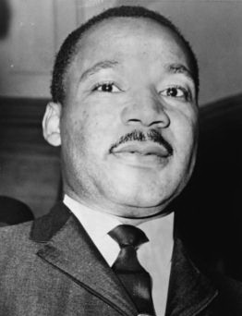
Loving our enemies
We never get rid of an enemy by meeting hate with hate; we get rid of an enemy by getting rid of enmity.
Martin Luther King Jnr.

Slide 29
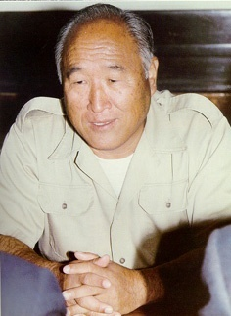
Loving our enemies
Jesus did not condemn any of his enemies.
His power was the power of love.
Sun Myung Moon
Notes:
True Father in Danbury – his heart to America – also to Kim Il Sung etc

Slide 30
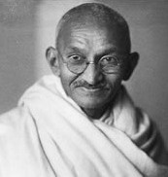
Loving our enemies
When I despair, I remember that all through history the ways of truth and love have always won.
Mahatma Gandhi

Slide 31
Our Choice – resolve or repeat past conflicts
Past
Unresolved problems will be passed on to future generations, and in most cases be bigger and more difficult to solve.
Future

