Slide 1
SALVATION AND THE BLESSING PART I
Colorado Family Church
Basic Internal Guidance/Spiritual Formation Education
Alice Fleisher – 11/18/2020

Slide 2
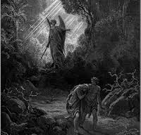
Salvation, Blessing Restoration Course
Restoration Course:
From the Divine Principle perspective, however, at a more core level we are the product of the history of what is referred to as the fall of man and the subsequent providence of restoration.
www,.artbible/art/large/482.html
He drove out the man; and at the east of the Garden of Eden he placed the cherubim, and a flaming sword which turned every way, to guard the way to the tree of life. (Genesis 3:24 RSV)
Notes:
We are the product of history – “a chronological record of events, as of the life or development of a people, country, or institution.” (American Heritage Dictionary). Surely, we can easily understand that each individual, what each of us calls our “I”, has been impacted by the lives and actions of our parents, grandparents and ancestors. We can also understand that those trail of events that have occurred within the nation of our birth, further played out within the larger community of nations, impacted and continues to impact our lives in such arenas as the opportunities or lacks thereof available to each of us or the social and material environment that may or may not have been available – commonly referred to as the impact of our social environment and socialization – both nature and nurture. The Fall: Illicit sexual union (spiritual bodies only) between the first woman (Eve) and the Archangel (Lucifer) and subsequently, the subsequent premature sexual relationship (physical and spiritual bodies) between this first woman (Eve) and the first man (Adam)
The result of these most foul deeds was that the linear progression of the human race was initiated based on events not intended or hoped for by our Creator and that further carried the footprint of those first evil actions because all subsequent human players were imbrued with a pseudo human nature grounded in those actions called the fallen nature in addition to their original, God-given human nature.
Its important to grasp the fact that the fall set a spiritual barrier or ceiling on humanity’s spiritual growth that could not be penetrated, effecting halting and limiting the forward momentum of humanity’s advancement toward achieving perfection or the realization of the First Blessing, to be spiritually fruitful or mature

Slide 3
Salvation, Blessing Restoration Course
Restoration through Indemnity
Indemnity: “Compensation for damage, loss, or hurt incurred; indemnification as that action or effort that must be done or paid because of past mistakes or injury.” (American Heritage Dictionary)
Man is situated in a mid-way position between God and Satan. The method to determine which side wins is through people making conditions of indemnity through which God or Satan can claim them as His own
Downloaded from Clipartkey.com
Notes:
The Providence of Restoration enters into this sorry state of affairs due to the absolute love and will of God to save humanity from their own evil doings and to finally achieve the fulfillment of His/Her plan and promise at humanity’s creation. This history encompasses Satan’s efforts to continue the status quo and to further the continuation/expansion of evil and God’s efforts to restore humanity, minus any trace of evil, the fall, and fallen nature, to a Godly state whereby they continually do good and fulfill their and god’s original Purpose of Creation.
Indemnity: “Compensation for damage, loss, or hurt incurred; indemnification as that action or effort that must be done or paid because of past mistakes or injury.” (American Heritage Dictionary)
Therefore, the course of Restoration involves indemnifying or making amends for specific past evil actions, not just stopping evil and doing good (in general). The underlying reason for this providence is that, because the fallen nature and since Satan was responsible for initiating the current human family, he can lay claim to all of those descendants but so can God, as the original creator of humankind. In fact, the restoration history reflects mankind/s constant relationship jockeying between God and Satan. Man is situated in a mid-way position between God and Satan. The method to determine which side wins is through people making conditions of indemnity through which God or Satan can claim them as His own. Therefore, until people make a condition through which God can claim them as His own, there is no way God can restore them to the heavenly side. In like manner, unless Satan finds some condition through which he can attack a fallen person, he also cannot arbitrarily claim him for his side. Therefore, a fallen person will go to God’s side if he makes good conditions and to Satan’s side if he makes evil conditions.

Slide 4
Salvation, Blessing Restoration Course
Restoration through Indemnity
When someone has lost his original position or state, he must make some condition to be restored to it. The making of such conditions of restitution is called indemnity.
Indemnity Conditions:
Three Types: Equal, Lesser, Greater
Notes:
Represent the reverse course of the mistake – example of taking a side trip on the road to San Francisco, must return the way you left the main road and continue on your way.
Who should set the indemnity conditions? The one who made the mistake: me, myself, or I - or descendants of those involved.

Slide 5
Salvation, Blessing Restoration Course
One Historical Indemnity Condition mentioned repeatedly in the Divine Principle:
FOUNDATION OF FAITH
Central Figure (representing Adam)
Object for the condition offered
Numerical Period
FOUNDATION OF SUBSTANCE
Archangel (Cain) must submit to and love Adam (Abel) thereby reversing the 4 fallen natures. Cain must not repeat the process of the fall, especially in relating to the Abel figure. Succeeding in this condition restores the 4 fallen natures –
Failure to see from God’s Point of View
Leaving one’s proper position
Reversal of Dominion
Multiplying Evil and Sin
FOUNDATION FOR THE MESSIAH
Notes:
One Major and Key Restoration through Indemnity course involving the utilization of Indemnity Conditions, that is found throughout the course of Restoration involves laying the Foundation for the Messiah which needs to be accomplished by the descendants of the fallen Adam and Eve. This Foundation is laid by setting up a Foundation of Faith and a Foundation of Substance.
For Adam to realize the purpose of creation, he was supposed to fulfill two conditions. First, Adam should have established the Foundation of Faith. The person to lay this foundation was Adam himself. The condition to establish this foundation was to keep strictly to god’s commandment while passing through a set growing period. The second condition, Foundation of Substance, was to become one with God, becoming the perfect incarnation of the Word with perfect character, completing God’s first Blessing.

Slide 6
Salvation, Blessing Restoration Course
Course to Meet the Messiah:
We, however, need to recognize that the ultimate purpose of the course of humanity to fulfill the Foundation for the Messiah is none other than for fallen humanity to meet and interact with the Messiah.
Downloaded from enlighteninglife.com
Notes:
Up to this point, I have spent a lot of time speaking about the role/position of fallen humanity in the Providence of Restoration to be rid of or erase the presence of evil or corruption within all of life’s experiences of humankind. We, however, need to recognize that the ultimate purpose of both courses is none other than for fallen humanity to meet and interact with the Messiah. The fulfillment of God’s providence occurs when the culmination of fallen humanities efforts meet with God’s salvation providence, which is spearheaded through His chosen Messiah. Now, though these are two distinct courses entailing two distinct arenas of responsibility, in fact since the Messiah absolutely represents God’s Heart/Love and Wisdom/Truth, we can understand that the Messiah will reveal and encompass a comprehensive understanding of fallen humanity’s historical and imminent course through the new truth brought in order to support and empower those walking that course of restoration. The Messiah must tell us how we got to the point of meeting, what we should do to make the most of that meeting and what we must be doing going forward from that most significant encounter.

Slide 7
Salvation, Blessing Restoration Course
Colossal City in Space – Amazingfacts.org
The Advent of the Messiah must occur as an actual, substantial event, rooted in the Original Principle of Creation, since the Advent comes in fact as as Messiah couple, the new Adam and Eve (I Corinthians 15:22,45 & Romans 5:14):
Notes:
1) According to God’s original purpose of Creation, the mandate for Adam and Eve to be fruitful (individual perfection), multiply (establish the social realm of human life, beginning with the family), and to take dominion (stewardship and lordship of creation) was to take place substantially.
2) Spiritual growth, achievement, and life is grounded on the foundation of the physical body and must take place in the corporal world for it to then exist in the spirit of a person and the spiritual world (Matthew 16:19)
The supreme mission of the Messiah is to finally establish the world of the Three Blessings, the ultimate purpose and Will of God for humanity that should have been established by and through the first Adam and Eve. It must be done in the corporal world.
In addition the mission of the Advent is to save fallen humanity from sin, specifically original sin. In one sense we can wonder that God would be willing to contend with this corrupted human race at all, why not just leave us to our own devices and just invest in the expansion of goodness from the good Adam and Eve. But that thinking doesn’t take into account the parental heart of God. (Matthew 18:13-14)
So God also intertwined a way by which salvation and cleansing of sin could be extended to fallen humanity by the Messiah concurrent with the Messiah’s task of building the Kingdom of God.

Slide 8
Salvation, Blessing Restoration Course
Jesus Ministry:
The focus upon Kingdom building and Kingdom living was absolutely dominant in the early ministry of Jesus.
Downloaded from 4thoseilove.wordpress.com
Notes:
The focus upon Kingdom building and Kingdom living was absolutely dominant in the early ministry of Jesus. This Kingdom building and Kingdom living ministry was the underlying theme/message woven repeatedly throughout Jesus’ words, guidance, parables, teachings and deed in those initial days of his public life. First came the shocking, urgent and electrifying proclamation by John the Baptist (Matthew 3:1-2). “In those days came John the Baptist preaching in the wilderness of Judea, ‘Repent, for the kingdom of heaven is at hand’. Then Jesus public ministry began where He widely taught the gospel of the kingdom (Matthew 4:17 & 23) “From that time Jesus began to preach, saying, ‘Repent, for the kingdom of heaven is at hand . . .And he went about all Galilee, teaching in their synagogues and preaching the gospel of the Kingdom and healing every disease and every infirmity among the people.” We need to underscore the fact that the ultimate purpose of Jesus coming was to qualify humanity to become citizens of a substantial Kingdom of heaven and further, to build/establish that Kingdom. In that light, Jesus ministry to save humanity from sin must be clearly understood as a prerequisite priority or step needed for humanity and Jesus to accomplish that ultimate goal.

Slide 9
Salvation, Blessing Restoration Course
HOW WAS JESUS GOING TO SAVE HUMANITY AND BRING THE KINGDOM?
REBIRTH!
John 3:1-12:
Now there was a man of the Pharisees, named Nicodemus, a ruler of the Jews. This man came to Jesus by night and said to him, ‘Rabbi, we know that you are a teacher come from God; for no one can do these signs that you do, unless god is with him.’ Jesus answered, ‘Truly, truly, I say to you, unless one is born anew, he cannot see the Kingdom of God.’ Nicodemus said to him, ‘how can a man be born when he is old? Can he enter a second time into his mother’s womb and be born?’ Jesus answered, ‘Truly, truly, I say to you, unless one is born of water and the Spirit, he cannot enter the Kingdom of God. That which is born of the flesh is flesh and that which is born of the Spirit is spirit. Do not marvel that I said to you, ‘You must be born anew’. The wind blows where it wills, and you hear the sound of it, but you do not know whence it comes or whither it goes; so it is with everyone who is born of the Spirit.’ Nicodemus said to him, ‘How can this be?’ Jesus answered him.’ Are you a teacher of Israel, and yet you do not understand this? Truly, truly, I say to you, we speak of what we know, and bear witness to what we have seen; but you do not receive our testimony. If I have told you earthly things and you do not believe, how can you believe if I tell you heavenly things?
Notes:
Jesus’ Kingdom building mission was a progressive providence that could only advance to the Kingdom building stage if Satan could be made to relinquish his dominion and ownership of humanity. Clearly, sinful humanity could not be allowed to enter into God’s Kingdom – sin has no place in such a realm. The method by which this providence to separate humanity from Satan, thereby allowing a saved individual to enter into God’s Kingdom, was to be accomplished through a process call “Rebirth” in Biblical terminology and the Blessing Unificationist’ terminology. We find this key insight in the Book of John, Chapter 3-1-12, when Jesus was speaking to Nicodemus.
Just a note, the reference to being born of water and spirit refers to the Jewish tradition of cleansing that dates back to the Torah, specifically Leviticus chapters 13-15. It refers to the rebirth process as providing cleansing of sin from the body and spirit (not to Baptism as found in the Christian tradition

Slide 10
Salvation, Blessing Restoration Course
Rebirth and Jesus
Jesus was meant to be the parent who came from Heaven. He came as the True Father in order to give rebirth to fallen people, transforming them into good children, thoroughly cleansed of original sin and fit to build and enter into the Kingdom of Heaven on earth. However, a father alone cannot give birth to children. There must be a True Mother, as well as a True Father, for fallen children to be reborn as good children.
Notes:
Upon Jesus’ crucifixion, his eleven remaining disciples sere demoralized and scattered. After his resurrection, however, Jesus gathered them in one place and commenced a new phase of the providence: the restoration of spiritual Canaan. The disciples chose Matthias to replace Judas Iscariot and fill the vacancy among the twelve. By believing in Jesus and following him at the cost of their live, they laid the spiritual foundation of substance and the spiritual foundation for the Messiah. Upon this foundation, Jesus ascended from the position of the spiritual mission-bearer of John the Baptist to the position of the spiritual messiah and sent the Holy Spirit. Thereupon, Jesus and the Holy Spirit became the spiritual True parents and began the work of giving rebirth. Ever since the descent of the Holy Spirit at the Pentecost, the resurrected Jesus as the spiritual True Father and the Holy Spirit as the spiritual True Mother have worked in oneness to grant spiritual rebirth by spiritually engrafting believers with them. This is the work of spiritual salvation, which established a realm of resurrection inviolable by Satan. Even though we may by faith unite with Jesus in spirit, our bodies are still liable to Satan’s attack, as was the case with Jesus himself, In other words, our physical salvation still remains unaccomplished. Still, if we believe in the resurrected Jesus, he will guide us to enter spiritually his realm of resurrection, which is invulnerable to satanic invasion. There we are released from the condition which allow Satan to accuse us, and we are spiritually saved.
(The True Owners in Establishing the Kingdom of peace and Unity in heaven and on Earth II – 10/14/06)
Jesus was meant to be the parent who came from Heaven. He came as the True Father in order to give rebirth to fallen people, transforming them into good children, thoroughly cleansed of original sin and fit to build and enter into the Kingdom of Heaven on earth. Thus, it is written in the Bible, “By his great mercy we have been born anew to a living hope through the resurrection of Jesus Christ from the dead (I Peter 1:3). Jesus came as the True Father who Adam had failed to become. For this reason, the Bible speaks of him as the “last Adam; and the Everlasting Father (I Cor. 15:45, Isa 9:6).

Slide 11
Salvation, Blessing Restoration Course
The Divine Principle explains that God’s initial plan for His creation required that Adam and Eve, His first and true son and daughter, if tempted, avoid the Fall, reach perfection and become the originators, prototype, standard and model for all subsequent humanity who would be born through them, the True Parents of humanity.
Two trees garden of eden steemit.com
Notes:
One of the Divine Principle’s incredible and monumental insights is its clarification that the process and sacrament of rebirth is integrally connected to the persons of Adam and Eve.

Slide 12
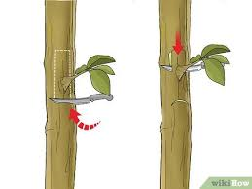
Salvation, Blessing Restoration Course
CLEANSING OF SIN = SALVATION = ENGRAFTING = REBIRTH
Being a sinner is not just about behavior or activity but, at its root, our state of sinfulness exists because we owe our life and birth to that first fallen action and thus belong to the lineage that developed as a result of it.
From Wikihow.com
Notes:
When Adam and Eve did not fulfill this plan of God, he did not discard it, but put into play the Providence of Restoration to reclaim the position of Adam and Eve or that of True Parents of humanity. At its core, the persons of the reclaimed Adam and Eve are synonymous with the persons and mission of the Messiah. This is the root and reason for the Bible’s identification of Jesus as a second Adam.
We can suppose that the offspring who are to born from the new and fully perfected Adam and Eve, or True Parents of Humanity, and the subsequent generations from this lineage, would be born ‘correctly’ or in accordance with God’s initial plan for His creation and having nothing to do with sin, at least from their birth, just as the first Adam and Eve initially were born without sin.
But how is God to save the issue from the first and fallen Adam and Eve? In addition to the rebirth imagery we also have the imagery of engrafting, as well as cleansing. We do affirm that the plant being engrafted becomes part of the original tree. Or that a dirty person cannot be cleansed by taking a bath in muddy water, only a person who has no sin can cleanse humanity of sin and one would not engraft onto a unhealthy plant. However, to describe the process of prerequisite for entering into the Kingdom which is connected to cleansing of sin, in the imagery of the birth process, is revolutionary. In fact, there is an equal connection between salvation, engrafting, and rebirth: salvation = engrafting=rebirth. This clarifies that salvation involves a process likened to being born. Why? The answer lies in the revelation that being a sinner is not just about behavior or activity but, at its root, our state of sinfulness exists because we owe our life and birth to that first fallen action and thus belong to the realm that developed as a result of it.

Slide 13
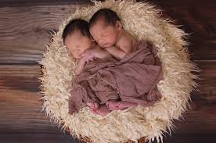
Salvation, Blessing Restoration Course
The Fall and Rebirth:
We cannot be born or subsequently reborn without parents. Who, then, are the good parents through whom we can be born again, cleansed of original sin and able to enter the Kingdom of God?
That would be the New Adam and Eve, the True Parents of Humankind. We are engrafted onto their lineage and, as a result, are separated from the original sin.
Astrokapoor.com
Medium.com
Notes:
Humanity was incorrectly initiated because of a mistake (remember, the children of Adam and Eve were not born in the Garden of Eden but after Adam and Eve had fallen and been expelled). So the cure for this illness must involve humanity being from and Adam and Eve who avoided the trap of Satan and acted according to God’s original plan. Such a solution to this fallen state attacks sin at its root cause by effecting a transition and transformation al process away from the evil, ill-conceived root.
What a stroke of genius and incredible strategy, a prescription/cure targeting the nature of the illness! Humanity needs to be born again to correctly and entirely circumvent the realm and history of the fall. At the very center of this re-birth or right-birth process is the position of the alternative and new life and birth givers, the good and True Parents. This is why humanity must be born again through the new Adam and Eve, the True parents, who will give ‘birth’ to a new destined to dwell in God’s realm or Kingdom. It is only by this process and sacrament that all humanity can be distanced from the realm of sin, especially the original sin, which can only be restored by a new Adam and Eve and stand as new beings. We cannot be born without parents. Who, then, are the good parents through whom we can be born again, cleansed of original sin and able to enter the Kingdom of God? Parents who have original sin cannot give birth to children who do not have that sin.

Slide 14
Salvation, Blessing, Restoration Course
The Second Advent will be the time where Christ (Adam) must come to complete the rebirth/true birth process in both spirit and body. This requires that Christ (Adam) find Eve, and together they will fulfill the prophesy in the book of Revelation, Chapter 21, of the marriage of the lamb and the establishment of the Kingdom of God, the new heaven and the new earth. That means that the Second Advent of Christ must find his Bride, they must marry and stand as the True Couple and True Parents of Heaven, earth and humankind.
Medium.com
Notes:
Let’s jump forward from the mission and ministry of Jesus and the Holy Spirit, the spiritual True Parents of humankind as the channel for humanity to gain for salvation and rebirth to the foretold Second Advent of the Messiah.
Why is this advent necessary, what must that coming Messiah accomplish, and how will that be done? If you have learned anything from this presentation, you might surmise the providence of the Second Advent of Christ will have something to do with continuing the restoration of Adam (and Eve), substantiating the rebirth process, and moving forward in the providence to establish God’s Kingdom and you would be right!
The Second Advent will be the time where Christ (Adam) must come to complete the rebirth/true birth process in both spirit and body. This requires that Christ (Adam) find Eve, and together they will fulfill the prophesy in the book of Revelation, Chapter 21, of the marriage of the lamb and the establishment of the Kingdom of God, the new heaven and the new earth. That means that the Second Advent of Christ must find his Bride, they must marry and stand as the True Couple and True Parents of Heaven, earth and humankind. This new Adam and Eve will be responsible to provide rebirth to humankind and stand as the True Tree(s) that those who were born into Satan’s lineage due to the fall, can be engrafted onto. By this process, humanity can be truly and fully saved and purged from the root of sin and a sinful lineage to a sin-free future and lineage.
Please refer back to my points that this Advent must be substantial and on the earth. That the Christ will return as a man born of woman who will not be Jesus as he will have his own name (Rev. 12 and14). This Christ (Adam) must find Eve, also born of woman, who will embody the Holy Spirit substantially.
The next question is the method or how this providence will take place! In the Unifications' understanding and teaching, this process is to be accomplished through the SACRAMENT OF THE BLESSING!

Slide 15
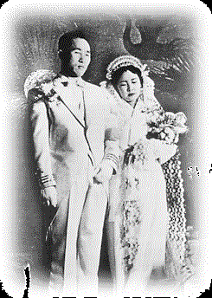
Salvation, Blessing
The Blessing: Substantial Rebirth
the Blessing Sacrament is a substantial sacrament of Grace that grants rebirth, a complex process with the power to remove original sin, through engrafting couples onto the True Parents who are the new Adam and Eve and the source of new lineage.
The Actual Marriage of the Lamb
Notes:
I will not go into detail at this time regarding all the aspects, components, and ceremonies of the Blessing Sacrament, which make it a substantial indemnity condition and providence, a complex process with the power to remove original sin, through engrafting couples onto the True Parents (New Adam and Eve) and the new lineage that flows from that source, the rebirth process. An introduction to that providence will be briefly covered in the coming presentation.
Let me instead convey the following as an introduction to that providence (from the Divine principle):
The providence of restoration refers to God’s work to restore human beings to our original, unfallen state so that we may fulfill the purpose of creation. As discussed in Part I, human beings fell from the top of the growth stage and have been held under Satan’s dominion ever since. To restore human beings, God works to cut off Satan’s influence. Yet, as was explained in Christology, we must have the original sin removed before we can sever Satan’s bonds and be restored to the state before the Fall. This is possible only when we are born anew through the Messiah, the True Parents. To explain further: we first need to go through a course to separate Satan from ourselves. We do this in order to restore ourselves in form to the spiritual level which Adam and Eve had reached before the Fall-the top of the growth stage. On this foundation, we are to receive the Messiah and be reborn and thereby be fully restored to the original state of human beings before the Fall. Finally, by following the Messiah, we should continue our growth to maturity where we can fulfill the purpose of creation.

Slide 16
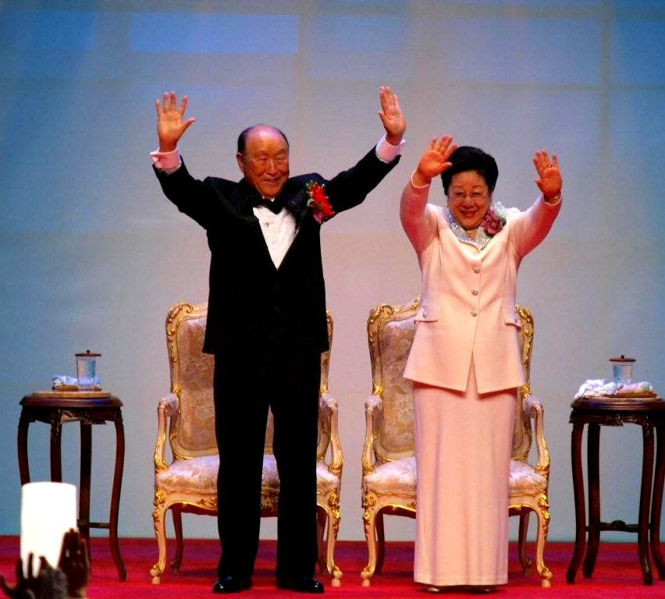
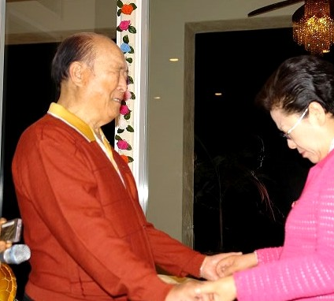
Salvation, Blessing Restoration Course

