Slide 1
SIN, RESTORATION PART II RESTORATION THROUGH INDEMNITY
Colorado Family Church
New Member Internal Guidance/Spiritual Formation Education
Alice Fleisher – 9/16/2020

Slide 2
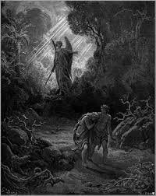
RESTORATION THROUGH INDEMNITY
Restoration through Indemnity refers to the reality that a crucial part of the restoration process depends on humankind taking responsibility for the presence of sin in their lives and the world.
www.artbible.info/art/large/482.html
Notes:
After the fall, due to humankind’s original ancestors Adam and Eve, devolving from a life connected only to God by committed the original sin. Through this fallen act they joined into the false blood lineage that was initiated and is lorded over by Satan, acquired the fallen nature and now lead a life characterized by an environment and nature of sinfulness. Humankind came to stand in a midway position where they were relating to both God and Satan. The providence away from this lukewarm state requires that humankind correctly fulfill their portion of responsibility by making conditions whereby that person can work towards gaining their original state or position and move closer to God. This providence is called making conditions of indemnity. There are three types of these conditions: Equal, Lesser (involves grace), and Greater (than lesser).

Slide 3
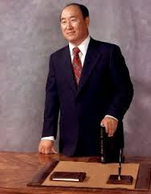
RESTORATION THROUGH INDEMNITY
Restoration through Indemnity is possible due to the principle of human’s portion of responsibility. Humankind fell because they used their portion of responsibility incorrectly. The restoration course uses this same principle, but requires us to take responsibility to correct or rectify our mistakes or wrong actions.
Notes:
“If God had not given fallen human beings a portion of responsibility, the term “restoration through indemnity” would not have appeared. Simple restoration would have been enough. You must pay indemnity! Why? It is because human beings do have a portion of responsibility. Since human beings violated their given portion of responsibility, they must fulfill it. To do so, you must win over everything that belongs to the satanic world and in a dignified manner, rid yourselves of its climate of opposition. You must enter a place where you can receive God’s love. If you accomplish this, Satan will depart from you. (Moon, Sun Myung, 2014 CSG, Book 8, Chapter 4, Section 5, 143-77, 1986.3.16)

Slide 4
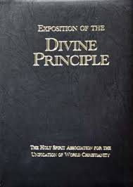
RESTORATION THROUGH INDEMNITY
Restoration Through Indemnity – Going the Reverse Course.
For anyone to be restored to the original position or state from which he fell, he must make an indemnity condition by reversing the course of his mistake.
The key mantra should be –
“When given the opportunity, do the right thing”.
Notes:
We call this process of restoring the original position and state through making conditions, restoration through indemnity, and we call the conditions made a condition of indemnity. God’s work to restore the people to their true, unfallen state by having them fulfill indemnity conditions is called the providence of restoration through indemnity . . . Next, let us study the method of fulfill indemnity conditions. For anyone to be restored to the original position or state from which he fell, he must make an indemnity condition by reversing the course of his mistake. . . * * * Who should make indemnity conditions? Earlier, we learned that human beings should have become perfect by fulfilling their responsibility; they then would have had the authority to govern even the angels. Yet the first human ancestors failed in their responsibility and thereby fell into the state where they were dominated by Satan. To escape from Satan’s dominion and be restored to the state where we rule over him, we ourselves must fulfill the necessary indemnity conditions as our portion of responsibility. (From the Exposition of the Divine Principle, 2006, Pp. 177-179)
Another way to understand the way of “doing the right thing” is that it involves going the way of sacrifice of selfishness, preferring the way of love or living for the sake of others. The following quote from True Father highlights this (from CSG, 2014 version, Book 3, Chapter 3, Section 2, #8, Pg 336):
#8. Let us go the path of love that God wants us to go. Only when we reject the path of the Fall that the devil wants us to go, and follow the path of love that God wants us to go, can we be separated from the devil. We cannot be separated from Satan by our worldly knowledge, by our understanding of doctrine, or by having better skill or wisdom. Love is what enables it. The reason Christianity has endured to this day is because it promotes the way of self-sacrifice, even to the extent that many believers have sacrificed themselves, willing to go the path of martyrdom and shedding their blood.
Though such an extreme course is not usually required of us, still the attitude of living and sacrificing for the sake of others reflects the internal providence of restoration through indemnity

Slide 5
RESTORATION THROUGH INDEMNITY
Let’s review some of the mistakes that were made by humankind, and which need to be restored through indemnity.
Self-firstness
Types of Sin
Four Fallen Natures
Gave into the Temptation to Substantiate Evil Action or Deed
Fineartamerica.com
Notes:
Remember the definition of sin: “Sin is a violation of heavenly law which is committed when a person forms a common base with Satan, thus setting a condition for give and take action with him. (Moon, Exposition of the Divine Principle, 4.5, Pg 72)
Sin: 1) Original Sin 2) Ancestral Sin; 3) Collective Sin; 4) Personal Sin;
Th four fallen natures
The four fallen natures: 1) Failure to take God’s standpoint; 2) Leaving one’s proper position; 3) Reversing dominion; 4) Multiplying the criminal act.
Failure to fulfill one’s Portion of Responsibility.
Failure to continually connect to God and ask God wisdom, insight, and Will.
Act in an unprincipled manner, repeating the fall (again, and again, and again, and again…..)
When you choose to continually deny your fallen impulses, you begin the process of fulfilling our portion of responsibility to indemnify that stain and scourge which began with the original sin.

Slide 6
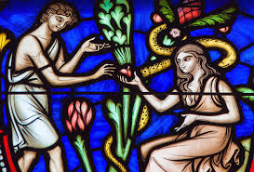
RESTORATION THROUGH INDEMNITY
The original and subsequent sins play out in our lives:
“The whole purpose for which we are now in the Unification Church is to indemnify the failure of Adam’s family. We must have a clear understanding of this point. Every one of us has come from our ancestors, Adam and Eve and the angel.” (Sudo, 1975, Sin and Salvation)
Images of Adam and Eve. jpeg
Notes:
Then if we observe ourselves, sometimes we stand in the same position as Lucifer, who tempted and seduced Eve. Sometimes we are like Eve, who was tempted and seduced by Satan. If she just feels like Eve, when some temptation comes, it is the same nature as Eve. Sometimes we are like Adam, who was tempted by Eve. If fallen Eve comes – this means some woman, mainly from outside, comes to you, comes close to you, then some of us might be tempted by the fallen Eve. If we feel some lustful desire, then it is the same as the fallen Adam. Some are like the angel, some are like Eve, some are like Adam, and some are like Cain who killed Abel, some are like Abel, who was arrogant. Some are like Seth, who didn’t understand anything at all. Spaced-out Seth… (Sudo, 1975, Sin and Salvation)
“If some of us do not like some of our brothers and sisters and say, “I don’t like him, I don’t like her, “ or “It’s better for him or her not to be here” This means: “Oh, he or she shouldn’t be here. Maybe it’s better for him or her to go to the spiritual world because then I don’t have to see him or her anymore. It’s good.” therefore, if we hate someone or don’t like someone, if it is exaggerated, or if it is extended, it will lead to murder. This is Cain nature.
As you know, sin is a condition through which Satan can invade us. As long as I commit sin, as long as I am sinful, Satan can accuse and invade me. The purpose of Satan is to destroy the purpose of creation. The purpose of creation is the realization of three great blessings, the greatest happiness. Therefore, Satan’s purpose and plan is to destroy the purpose of creation, to destroy my happiness. (Sudo, 1975, Sin and Salvation)

Slide 7
RESTORATION THROUGH INDEMNITY
Just a word of advice for those of you who choose to resist the impulses stemming from their fallen nature, you do need to exercise caution to avoid being duped by and becoming victims of Satan.
Notes:
Just a word of advice for those of you who choose to resist the impulses stemming from their fallen nature, you do need to exercise caution to avoid being duped by and becoming victims of Satan. The Satanic forces are quite crafty and are very adept at initiating evil thoughts and actions. So, for example, you need to avoid putting yourself in a situation or environment where you will be weak to resist the power of fallen love (which is still stronger than reason). This would include avoiding being alone with someone of the opposite gender and quickly nipping the bud any impulses to sin. You must resist lustful thoughts and be clear that the morality of this world, especially related to pornography and/or sexual relationships before marriage and infidelity after marriage, has nothing to do with God’s Will or Way.

Slide 8
RESTORATION THROUGH INDEMNITY
The heavenly lifestyle, including the ethics and morality of the Kingdom of Heaven, will always involve walking the way of Love, service, and living for the sake of others.
Wallpaper-house.com
Notes:
The way of love is the way of giving yourself to be used by others for a higher purpose. Individuals who have love want to be used by their families, families who have love want to be used by their nation, nations want to be used by the world, the world wants to be used by the cosmos, and the cosmos wants to be used by God. This is the way of true love. (from CSG, 2014 version, Book 3, Chapter 3, Section 2, #9, Pg 336)
We must become people who always fulfill their portion of responsibility in accordance with God’s will, purpose, plan, and the requirements of the providence. This can be understood as part of the process of re-growing up which must follow from the transformational event of being reborn.

Slide 9
RESTORATION THROUGH INDEMNITY
The Road to Normal or Kingdom Lifestyle - Limit of Restoration through Indemnity
Restoration through Indemnity is powerful but needs to be understood in relationship to and coupled with that aspect of salvation which is referred to as Grace, which can only be accomplished through the providence of God through the Messiah
For a person belonging the fallen lineage, this diagram depicts the typical ratio between the original mind (inner circle) and the fallen nature (shaded blue area)
The restoration through indemnity course, at best, can expand the domain of the original mind and heart, but cannot get rid of the fallen nature completely.
Notes:
However, even with sustained earnest efforts at undoing the footprint of sinful and incorrect behavior through replacing those past patterns with righteous behavior cannot save humankind from the original sin. At best, this phase of the road to normal can be likened to expanding the beachhead of good into the enemy territory.
The Restoration through Indemnity involves continually choosing to do the right thing and following God’s will for our lives in light of the knowledge of the process of the fall and also the original ideal behavior that God planned for Adam and Eve. But as described in the diagram above, this behavior alone cannot save us. No, for us to be saved we need to be reborn through the True Parents, make continual efforts to Restore evil and sin through Indemnity, embody the heart of living for the sake of others, and strive to realize the ideal. When we continually do the right thing related to creating the ideal Four Position Foundation before and after receive the Blessing, our efforts will gradually transform or walk from a course of indemnity into a way of recreation where we embody a heavenly lifestyle characterized by doing the right thing. The heavenly lifestyle, including the ethics and morality of the Kingdom of Heaven, will always involve walking the way of Love, service, and living for the sake of others.
Restoration through Indemnity is powerful but needs to be understood in relationship to and coupled with that aspect of salvation which is referred to as Grace, which can only be accomplished through the providence of God through the Messiah. The central providence in relationship to man’s salvation is the course of the Messiah. The providence of the Messiah is connected to God’s 95% responsibility, while Restoration through Indemnity belongs to the realm of humankind’s 5% responsibility. Both are critical for it is only through their combined contribution that 100% Restoration can be accomplished. Ultimately that Restoration leads to recreation and the fulfillment of God’s Purpose of Creation, the accomplishment of the Three Blessings.

Slide 10
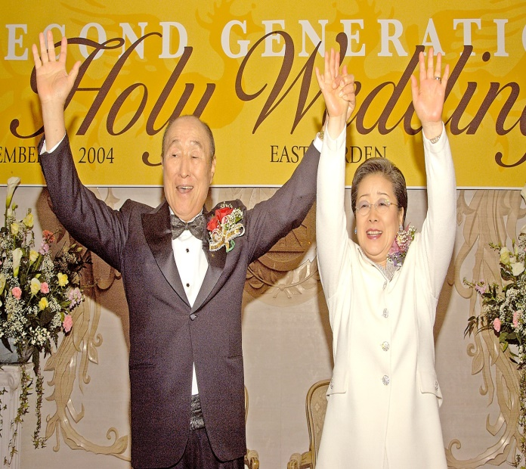
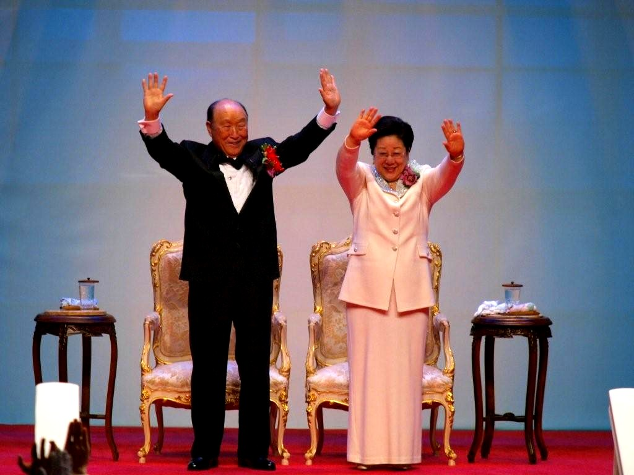
RESTORATION THROUGH INDEMNITY
The aspect of restoration known as rebirth is accomplished through a rebirth or engrafting providence which is known as the Blessing in Unificationist terminology, otherwise known as the change of blood lineage. Ultimately to fulfill this providence, God began the providence to send the Messiah to humankind. We will cover this in more depth in future presentations.
Notes:
The reason you and I cannot solve the problem of original sin is because it was the sin committed by Adam and Eve’s, and they must be the ones to initiate it’s restoration. This sin destroyed the four-position foundation, blocked the 3 Blessings from being realized, took away the good root and lineage; and introduced the disease of Satan-centered and selfishness into the human society. But this problem cannot be solved by the descendants of Adam and Eve who are a part of the subsequent fallen lineage. Instead, through a course designed God, a new Adam and Eve must appear, who must not disobey the commandment nor repeat the fall, but instead, they must correctly fulfill their responsibilities, establish a true couple approved by God, reclaim true parental, marital, and children’s love, and initiate a true lineage. This is the course of the Messiah Couple, who is ultimately can be understood as the True Parent’s, a true Adam and Eve. The course of salvation through the True Parents, for those belonging to the false, satanic lineage, is the process of rebirth spoken about by Nicodemus
“Now there was a man of the Pharisees, named Nicodemus, a ruler of the Jews. This man came to Jesus by night and said to him, ‘Rabbi, we know that you are a teacher come from God; for no one can do these signs unless God is with him.’ Jesus answered, ‘Truly, truly, I say to you , unless one is born anew, he cannot see the kingdom of god. Nicodemus said to him, ‘How can a man be born when he is old? Can he enter a second time into his mother’s womb and be born? Jesus answered, ‘Truly, truly I say to you, unless one is born of water and the spirit, he cannot enter the kingdom of God.” (John 3:1-12 RSV)

