Slide 1
SIN, RESTORATION PART III Formula Three Stages of Judgment
Colorado Family Church
Basic Internal Guidance/Spiritual Formation Education
Alice Fleisher – 9/7/2020

Slide 2
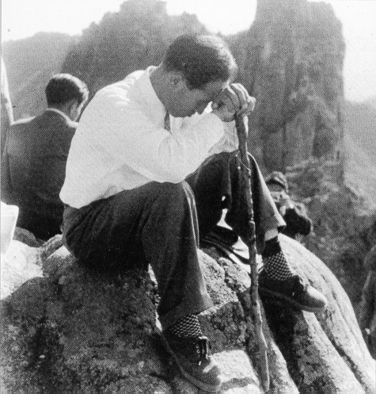
Sin and Restoration
The course of Restoration through Indemnity belongs to the realm of truth and spiritual law. The course that I will be examining in this section, called the Formula for God’s Providence, is steeped in the realm of heart and love.
FORMULA COURSE: 1) Separate yourself from Satan, 2) Come into the love of God, 3) Sacrifice yourself for the sake of other people
Notes:
This is the messianic course that desperately works to save the spiritual and physical lives of fallen humankind by working within the realm of this fallen world.
As each of us are called to be tribal messiah’s, it applies to us as well.
This section is concerned with the heart of love which is expressed through sacrificing for the sake of others
FORMULA COURSE: 1) Separate yourself from Satan, 2) Come into the love of God, 3) Sacrifice yourself for the sake of other people
Principle behind the Messiah’s Course:
“God was the Father. Would he not have the love which would not let His children go? He felt like forgiving them. But He could not do that. Therefore His pain was even greater. If there had been another son or daughter who had not fallen, and if this unfallen child could have asked God to save his brother and sister and give him their punishment instead, how would God have felt toward that third child? If there had been such a brother asking God to forgive Adam and Eve, God would have had a mind to forgive them. This heart of the Heavenly Father became the basis for God’s providence of salvation.”
“Suppose this third child of God’s had gone to Satan and snatched his own brother and sister back to God’s bosom. How would God have felt? Would He have punished them, or driven them out again or received them back? Would He have punished the brother who took them back? Would He have driven him out also? Or would he have praised him or left him alone?” (Moon, Sun Myung, 1973)

Slide 3
Sin and Restoration
Foundation of Faith and Foundation of Substance (Course of fallen humankind creating the Foundation for the Messiah, who first stands in the position of Abel to fallen humankind. Based on their faith, Abel can advance into the role of the Messiah):
The Crown of Glory
When I doubt people, I feel pain.
When I judge people, it is unbearable.
When I hate people, there is no value to my existence.
Yet, if I believe, I am deceived.
If I love, I am betrayed.
Suffering and grieving tonight,
My head is in my hands,
Am I wrong?
Yes, I am wrong.
Even though we are deceived, still believe.
Though we are betrayed, still forgive.
Love completely, even those who hate you.
Wipe your tears away and welcome with a smile
Those who know nothing but deceit.
And those who betray without regret.
Oh, Master, the pain of loving!
Look at my hands.
Place your hand on my chest.
My heart is bursting, such agony.
When I loved those who acted against me,
I brought victory.
If you have done the same thing,
I will give you the Crown of Glory.
Notes:
Principles active in the process of taking back that which is lost:
It cannot just be snatched back. God cannot forgive man who rebelled against Him unless man himself sets up the conditions to come back to God, denying Satan
Had the unfallen brother or anyone else gone to Satan and tried to take Adam and Eve back, Satan would not have let them go without a condition . . . Satan must be given something which he feels is more valuable than that which he is going to loose. In other words, there would have to be a man who is willing to sacrifice himself in place of his fallen brother. That sacrificial brother will become the second Adam, or Christ.
Someone must come who will experience God’s grief and his fallen brother’s grief and who is willing to do anything to relieve those suffering hearts. Another man must come who sheds tears not for himself but for God and his lost brother; they will be tears of hope. (Moon, Sun Myung, 1973)
To save Cain, there has to be Abel. Abel was in the position of the unfallen brother who asks God to forgive the fallen Adam and Eve because of him. To win that position, Abel has to first receive God’s love. That means, he had to come out of the sphere dominated by Satan. Once he had won that separation from Satan, God could love him. Having gained that position, instead of being arrogant, Abel should have been willing to die for Cain. These three stages are the important formula: 1) First the man who is willing to save the world should be able to defeat Satan; 2) then he must come into the love of God; and 3) feeling the heart of God and his fallen brother, he must be willing to sacrifice himself in place of his fallen brother, in order to relieve God’s Grief and his fallen brother’s grief. (Moon, Sun Myung 1973)
“Love God and love people at the price of your life”

Slide 4
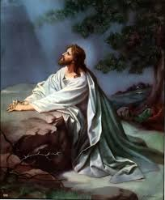
Sin and Restoration
The heart that drives this formula course is one that is deeply concerned with the situation of God, desiring to fulfill God’s will and purpose in order to comfort God’s heart, to the extent that their own lives and ambitions diminish in importance and sacrifice is not a burden, but a joy.
Sorrowful Jesus
Trinitybelleplaine.org
Notes:
Israel could have established God’s will. But the people didn’t receive Jesus, so Jesus along was determined to sacrifice himself for the nation and the world . . . He did not curse those who killed him. He prayed and asked God to bless them. Therefore, Jesus stood as the mediator between God and fallen mankind. He died as the unfallen Adam of the world. And he practiced the formula for the salvation of the people of the entire world. Therefore, he became the exemplary Adam. Whoever followed him received salvation. (Moon, Sun Myung 1973)
I want to teach you this: Love God and love people at the price of your life. Then you can gain your own life and gain all people also. That is what God wants from the bottom of His heart, and that is what Jesus wanted us to be like. When Jesus prayed at Gethsemane, “Father, let this cup pass from me, if it be possible, Nevertheless, not as I will, but as Thou wilt,” his heart was that of a son who loved only his Father. On the cross he loved even his enemy and prayed for him. There had never been such a man in all history previous to him, and there was no such man after him. That is the sign of his having loved the whole of mankind. That is what made Jesus the greatest. If you can do that much, you cannot help but be the friend of Jesus, or the bride of Jesus. You can have his Father as your own. You can have everything he had.
Now, let us conclude. Those who shed tears for themselves are fools, great fools. Those who shed tears for others are wise men, because they can win God and win the whole world and everything in it. By doing that, you can be the possessor of God’s love. In studying, you should not study for your own benefit or for you own sake, but you should study to save the whole world for God. When you marry, you must not forget that you are marrying for mankind, for the future of mankind. People with that heart cannot perish.
The place where such people meet, that is the KINGDOM OF HEAVEN! (Moon, Sun Myung 1973)

Slide 5
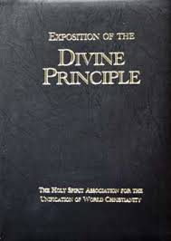
Sin and Restoration
Three Stages of Judgment
Another way to describe the Restoration providence and lifestyle is that each fallen person must pass through three stages to be qualified to enter into God’s dominion. Those three stages are: WORD, PERSONALITY, HEART.
Judgment of the Word – Become living examples of the Word of God.
“The Divine Principle is the measure or the way – the guide – that will take us through the path to reach God, and to the original position before the fall. Without going through this way, fallen men cannot reach the original position. This is the measurement, ruler, and fundamental guide . . . There must be a rule or standard to be met . . . The Divine Principle is the measurement by which God can liberate fallen men.” (Moon, Sun Myung 1973)

Slide 6
Sin and Restoration
Judgment of Personality:
Passing through the ‘Judgment of Personality’ requires you to be a person that will never falter in fulfilling God’s will, no matter the confusion that prevails. It is based on the recognition that the enemy that is working against God’s will is a spiritual one, thus the restoration efforts need to take this into account in developing their battle plan and strategy.
Ephesians 6: 10-20
Finally, be strong in the Lord and in the strength of his might. Put on the whole armor of God, that you may be able to stand against the wiles of the devil. For we are not contending against flesh and blood, but against principalities, against the powers, against the world rulers of this present darkness, against the spiritual host of wickedness in the heavenly places. Therefore, take the whole armor of God, that you may be able to withstand in the evil day, and having done all, to stand. Stand therefore, having girded your loins with truth, and having put on the breastplate of righteousness, and having righteousness, and having shod your feet with the equipment of the gospel of peace; besides all these, taking the shield of faith, with which you can quench all the flaming darts of the evil one. And take the helmet of salvation, and the sword of the spirit, which is the word of God. Pray at all times in the Spirit, with all prayer and supplication. To that end keep alert a with all perseverance, making supplication for all the saints.
Notes:
You must have such a personality with which you can never fall prey to Satanic temptation. Before death, in the face of death, Jesus extended his arms and said, ‘Kill me’ and at that instant he was not killed, and spiritually he was resurrected. If you are determined to lose your life for God, no Satan can kill you. You have eternal life there. Are you like that? If you are not like, God cannot bless you. If He does, the blessing will be snatched away by Satan. But if you are so determined to face death without fear, then God will bless you and it cannot be taken by Satan. That is how to win in the judgment of personality. Win over all the temptations coming from Satan, and go to the standard where God can bless you. That’s how it was with Jesus. (Moon, Sun Myung 1973)

Slide 7
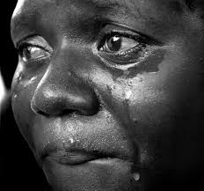
Sin and Restoration
Judgment of Heart:
This Judgment is another way of describing the Formula Course described in the beginning of this presentation. The focus is that each person needs to embody unselfish, sacrificial love, and serve God and humankind by seeking the fulfillment of God’s will through embodying that kind of love.
Notes:
How wonderful love must be if it is as pure as that. So true sacrifice must accompany true love . . . Before wanting to have God’s love, you must practice loving other people to that standard. You must long for not only your sweetheart, your lover, but you must miss every lost child of God with love of that kind. Until you are worn out in tears, until your legs are fatigued, until your whole energy is exhausted in search of that person, you must long for him.

Slide 8
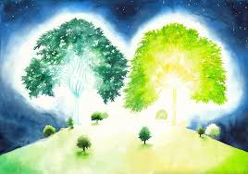
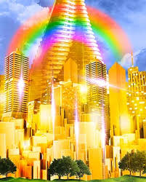
Sin and Restoration
The Kingdom of Heaven on earth is the dwelling place of those who have won in the judgment of heart. We will erect the Heavenly Kingdom on earth with our own hands. If we have that kind of love, God will come and abide in us and love among us. If every moment, in the process of loving, you feel that your love has not been enough, and if in repentance you want to have more love to be distributed to others, then the Heavenly Kingdom cannot but come through you. If you feel that your love is not enough, and you are tearful and struggle harder, then in the world of that kind of heart, the Kingdom of God can come. (Moon, Sun Myung 1973)
Two trees garden of eden steemit.com
Colossal City in Space
Amazingfacts.org

Slide 9
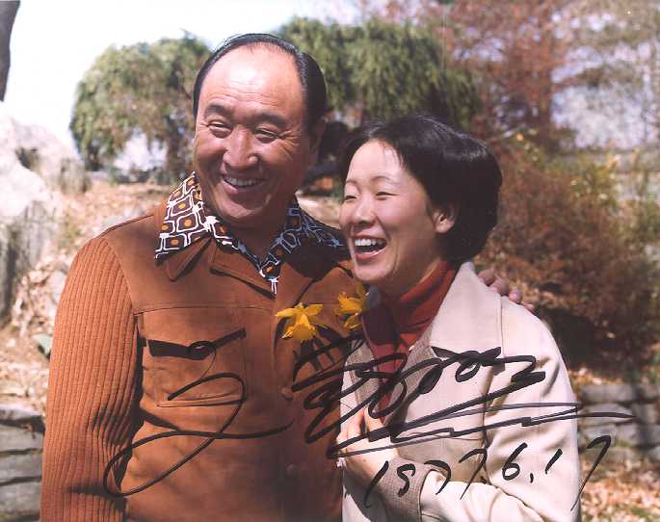
Sin and Restoration
Conclusion:
Let's strive to realize the following goals:
Keep God’s commandment to maintain absolute sexual purity before a Blessed marriage and absolute fidelity within a Blessed marriage.
Establish exemplary families who can inherit True Parent’s victory of restoring through indemnity the realm of God’s ideal.
Notes:
This presentation has attempted to introduce an additional dimension which a spiritual walk has to take into consideration: the reality of sin “out there” and “within ourselves”. For our effort to be successful we need to have a clear understanding of the goal and purpose for our spiritual walk and lives. We also need to understand and practice a lifestyle that is governed by and utilizes the spiritual laws of restoration: restoration through indemnity, the formula course for God’s providence, and the three judgments. God Bless you along your way. “Let us establish a model ideal family to bring the complete settlement of the universal, ideal realm of liberation and complete inner freedom, and the kingdom of goodness in which we can enjoy a time of absolute, unique, unchanging and eternal peace and prosperity, and which can become the homeland of peace and prosperity, and which can become the homeland of peace in heaven and on earth that can be praised for all eternity.” (Moon, Sun Myung 11/11/06)

