Slide 1
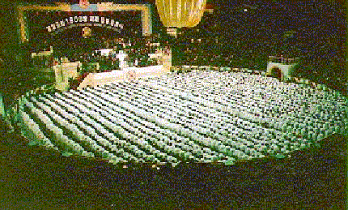
THE WAY OF THE BLESSED CENTRAL FAMIILY
Cheon Il Guk is the Ideal Heavenly Kingdom
of Eternal Peace
Sun Myung Moon
Fifth Message of Peace
June 13, 2006
Our Responsibility in the Era of Cheon Il Guk
Hak Ja Han Moon’s Words found in Cheon Seong Gyeong, Book 12
Presentation prepared by Alice Elizabeth Hamaker-Fleisher

Slide 2
The Path of the People of Cheon Il Guk
“Citizens of the kingdom of heaven, this is a precious and blessed day of victory and glory. Now, as the King of Peace in Heaven and on Earth, I will declare, on this thirteenth day of June in the sixth year of Cheon Il Guk, the fundamental duties and mission that every citizen of Cheon Il Guk should understand and live by as they walk the way of Heaven.”
The Reverend Sun Myung Moon

Slide 3
The First Duty and Mission The First of Seven That were Declared by True Father on June 13, 2006
First, as God is the vertical True Parent and you are true children of God, you will establish the realm of three generations in your family, perfect the Four Great Realms of Heart, and attend God on the vertical axis for eternity.
Further, you will inscribe on your heart the need to uphold the King of Peace in Heaven and on Earth, who is the horizontal True Parent, and to live with absolute obedience on the horizontal axis for eternity as a citizen of Cheon Il Guk. You will make living for the sake of others, which is the practice of true love, the standard for your life. You will establish a true family and raise true children who are sinless and pure, thus protecting God’s lineage and bequeathing it intact from generation to generation.

Slide 4
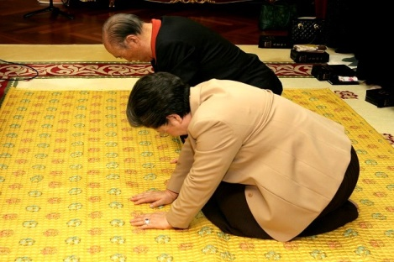
How Shall We Attend God on the Vertical Axis for Eternity?
You must become filial sons and daughters who can attend the God who has suffered in sorrow throughout history, who can comfort Him, and offer Him joy and glory. Even now, God laments in disappointment. Hence, you must reach the point where you can welcome the day of God’s victory; and not only you but all humankind with you. To comfort God’s heart of bitter sorrow, you must attend Him, beyond your own people and beyond the world, to advance with the full authority of the cosmos. You need to devote yourselves to becoming children of God whom God wants to bless rather than judge. You have to become a group of people who can endure. No matter what cruel situations or adverse circumstances you suffer, you should be able to say, “even if no one else remains, I will survive.” Only with this kind of heart can you connect your life to God. If you have this kind of relationship with God, even though strong winds and mighty storms may come against you, nothing can destroy that bond of heart, which holds the power of life. (CSG, Book 1, Chapter 4, Sect. 1, #6, Pp 94-95)

Slide 5
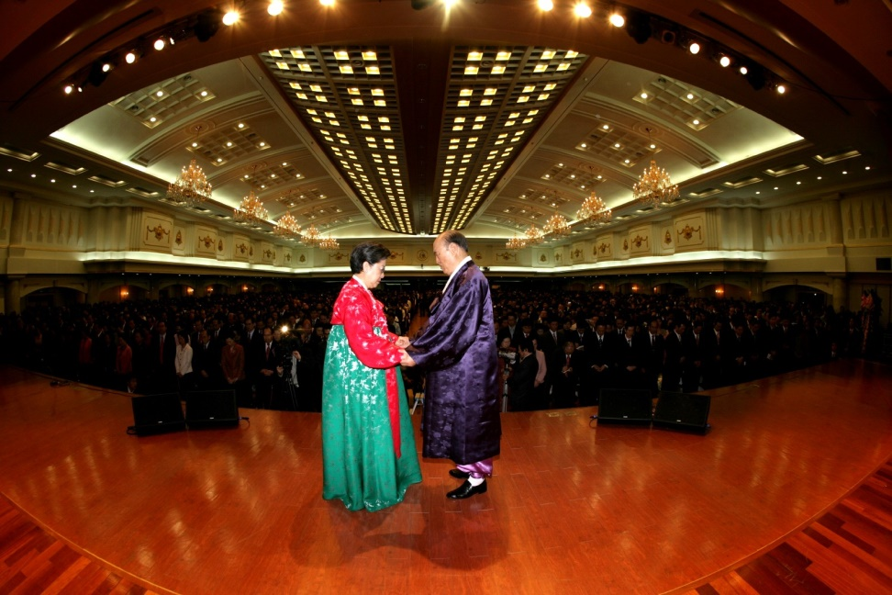
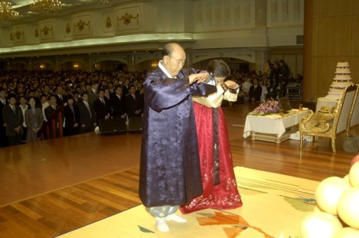
How Shall We Attend God on the Vertical Axis for Eternity?
The reason God continues to lead providential history, even repeating it, is to inspire people to respond to His providence. Only in this way can He stand in front of humankind as the God of the ideal. Yet to human beings who live in the realm of Satan, God appears as the fearful God of judgment. To attend God as the God of the ideal, we must be able to experience the grief that was caused Him by the human Fall. We must be able to establish a relationship in which we can abide with Him in His grief. Otherwise, God cannot appear to us as the God of the ideal and cannot appear to us as the Lord of the ideal of creation. On the way to attend the God of the ideal, our path requires that we fight the evil forces that constantly try to block us. This is the path of restoration through indemnity that is required of fallen human beings. (CSG, Book 1, Chapter 4, Sect. 1, #65, Pp 112)

Slide 6
The Second Duty and Mission The Second of Seven That were Declared by Rev. Sun Myung Moon on June 13, 2006
Second, no matter what the situation, you will live with your mind and body united as one. In my case as well, from the day I first determined to follow Heaven’s path, I resolved to keep this as my motto: “Before you desire to have dominion over the universe, you must first gain dominion over yourself’ God has given you a conscience as your guide in accomplishing this objective. Your conscience knows everything about you. It has complete knowledge of every action and step you take; it even knows your thoughts. Your conscience knows all these things about you before your teacher or pastor knows. It knows them before your parents know. It knows them even better than God knows.
So if you place your conscience in God’s position over your life, and go the way of absolute obedience, of “high noon” settlement whereby your life casts no shadows, it is certain that you will establish a realm of resonance between your mind and body and perfect their unity.

Slide 7
The Third Duty and Mission The Third of Seven That were Declared by Rev. Sun Myung Moon on June 13, 2006
Third, the unification of the spirit world has been completed. The issue now is the people living on earth, in their physical bodies. They struggle in agony in the midst of sin and suffering, yet they are your brothers and sisters. Your third mission is to educate them and bring them home as people of Cheon Il Guk. You need to educate everyone to understand that all human beings without exception are descended from the Fall, and that they have to change their blood lineage through receiving the Holy Marriage Blessing from the True Parents. You need to continue the work of engrafting people onto the true olive tree, by having them participate in the grace of intercultural marriage, until the day when all human beings, numbering more than three hundred billion souls, are restored to God’s lineage.

Slide 8
The Fourth Duty and Mission The Fourth of Seven That were Declared by Rev. Sun Myung Moon on June 13, 2006
Fourth, you are created to spend about ten months in your mother’s womb, about one hundred years on earth breathing air, and then all eternity in the spirit world. You need to understand that, just as proper preparation in the womb is required for a healthy life after birth, you need to devote your earthly life to preparing yourself for the next stage of life in the spirit world. Never forget that in every time and place, and no matter what you are doing, your ancestors in the spirit world are with you. Be ever mindful to live in harmony with the spirit world. Communicate in prayer with the heavenly world with sincerity and dedication, so that you may become perfected in your spirit self while you are living on earth.

Slide 9
The Fifth Duty and Mission The Fifth of Seven That were Declared by Rev. Sun Myung Moon on June 13, 2006
Fifth, your talents and abilities are required for the management and governance of Cheon Il Guk. Now therefore, cut away and cast off your mask of selfish individualism. It is just a remnant of the Era before the Coming of Heaven. In order to belong to Heaven, you have to change ownership by participating in the Ceremony of Returning Ownership, offering everything you own to God and then receiving it back from God.
In addition, all citizens of Cheon Il Guk will provide funds for the wellbeing and peace of humanity, by taxation and by voluntary contributions. They will demonstrate the model of offering the first three-tenths of their income for public purposes. This cannot be an imposed tax; it has to be a gift that citizens offer willingly to Heaven with joyful hearts.

Slide 10
The Sixth Duty and Mission The Sixth of Seven That were Declared by Rev. Sun Myung Moon on June 13, 2006
Sixth, beloved citizens of Cheon Il Guk, in the Era after the Coming of Heaven it is possible to recover the ideal world of creation that was lost as a result of the Fall. God created everything in the universe as our natural environment; all things are absolutely needed for human prosperity. Human beings and nature are meant to share a realm of mutual resonance, with men and women as the subject partners of love and nature as the object partner thriving under our management and beautified by our creativity. We can no longer ignore or accept actions that destroy nature and pollute the environment. As citizens of Cheon Il Guk, please exercise wisdom to protect and love nature. Return to nature and enjoy a life of liberation and complete inner freedom. To love nature is to love God and humanity. When human life resonates with nature, human character can blossom in perfection. The flowers of a true culture of heart, a true artistic world, will bloom. It will be the Garden of Eden, the original ideal world where God, human beings and all creation live in complete harmony and express their original nature. If you practice such true love in your daily life, how can God do anything but bestow great blessings upon you? You will live for all eternity in blessing and happiness.

Slide 11
The Seventh Duty and Mission The Seventh of Seven That were Declared by Rev. Sun Myung Moon on June 13, 2006
Seventh, the Era after the Coming of Heaven that God and True Parents have opened is a time of dramatic change. As registered citizens of Cheon Il Guk, you have the mission to make this era blossom and bear fruit in blessing and glory. Therefore, please become Heaven’s emissaries, fulfilling the dual missions of the peace kingdom police force and peace kingdom corps. Serve humanity under the banner of the Universal Peace Federation, which is working to establish the position of the Abel UN. Worthy countrymen and women, if not you, then who will nurture and protect the blessed families and this blessed planet Earth that God has given us? Please become true princes and princesses who live in attendance to God as your vertical True Parent, for He is the Peace King of the multitudes. Let us build the everlasting peace kingdom by attending the King of Peace in Heaven and on Earth and fulfilling the dutiful family way of filial sons and daughters, patriots, saints, and divine sons and daughters.

Slide 12
The way we need to go from now words of Hak Ja Han Moon
At this new transitional point in providential history, I want to make clear that I shall inherit True Fathers victorious foundation and stand at the forefront to lead the providence on earth. While doing so, there are several things I would like to convey to everyone. (2012.09.17, Cheongshim Peace World Center)

Slide 13
The Way we need to go from now - words of Hak Ja Han Moon
First, we must absolutely value the tradition True Parents established as much as we value our own life, and pass it down to our descendants, the future generations. True Parents established the tradition of love and heart, the tradition of the Word and the rules and regulations, and the tradition of the culture of heart. The Hoon Dok Hae tradition of reading the Word, which is the crystallization of True Parents' course in the providence of restoration through indemnity, should become the central practice in each family, as well as in the church and at any gathering centered on Heaven. At the same time, we need to go forward in creating a new order on earth. Please never forget True Parents' tradition, based upon which our organization will be developed and united as one body. It will have perfect order, based on the True Family, with True Parents as its center and Abel figure. (2012.09.17, Cheongshim Peace World Center)

Slide 14
The Way we need to go from now - words of Hak Ja Han Moon
Second, we need to complete the ideal of the blessed family, with which Heaven has blessed us. The family is the cradle of true love, true life and true lineage, and the base upon which God's purpose of creation is realized. Based on the eight verses of the Family Pledge, you should uphold the tradition of the absolute good lineage with absolute faith. Our vision for peace evokes pure love, happy families and a peaceful world. Blessed couples should raise their children through love and the Word in a tradition of attending Heaven with absolute love and attaining complete oneness. Through Hoon Dok Hae in your families, you should foster the firm establishment of the Cheon Il Guk order and fulfill the ideal of the Blessing. That is how the tradition of heart can take root both vertically and horizontally according to the standard of vertical, high noon alignment. (2012.09.17, Cheongshim Peace World Center)

Slide 15
The Way we need to go from now words of Hak Ja Han Moon
Third, you have all received the blessing of being tribal messiahs, which is your mission and responsibility until the time we complete Cheon Il Guk on earth. Tribal messiahship is the greatest of all blessings given by True Parents. It could not come to fallen people without the foundation of victory True Parents established in the providence of restoration through indemnity. That is why True Parents consistently emphasized the tribal messiah mission during their lifelong governance of the providence. The completion of Cheon Il Guk in heaven and on earth becomes possible when tribal messiahs fulfill their responsibility to share the Word and the Blessing with their tribes and live for the sake of others. This will establish a realm of goodness, a peaceful world and the ideal of humanity living as one global family. (2012.09.17, Cheongshim Peace World Center)

Slide 16
The Way we need to go from now - words of Hak Ja Han Moon
Fourth, we will create a community based on the culture of heart, in harmony and unity, with True Parents and true families. Each of you, without exception, found the path of God's Will because Heaven chose you. It was based on the merits of your ancestors and because of the character you personally acquired. In order to follow True Parents and enter this realm of victory that we have now, you have faced immeasurable persecution. That makes us all a part of a single family, a community of heart centered on one Parent. Division and conflict continue to afflict the world, but the Unification family can become brothers and sisters who can easily transcend race, nation and any barrier. If you can display an exemplary life of giving and living for the sake of others, this dream will surely come true. Especially in this time of great transition in the providence, I ask that you unite with True Parents in your heart. (2012.09.17, Cheongshim Peace World Center)

Slide 17
The Way we need to go from now - words of Hak Ja Han Moon
Although True Father is in the spirit world, he is always with us. He exists without corporeal form, but he never leaves our side even for a moment. What do you think he desires from us at this time? He desires that we march forward without pausing. God's providence has to continue throughout the world until, with True Parents as the center, love and peace overflow, a culture of heart settles, and a new order is established. Moreover, from the victory of Foundation Day, we should advance further to offer great glory to Heaven and to True Parents, and to instill great hope as we stand before the world and before all of history. (2012.09.17, Cheongshim Peace World Center)

Slide 18
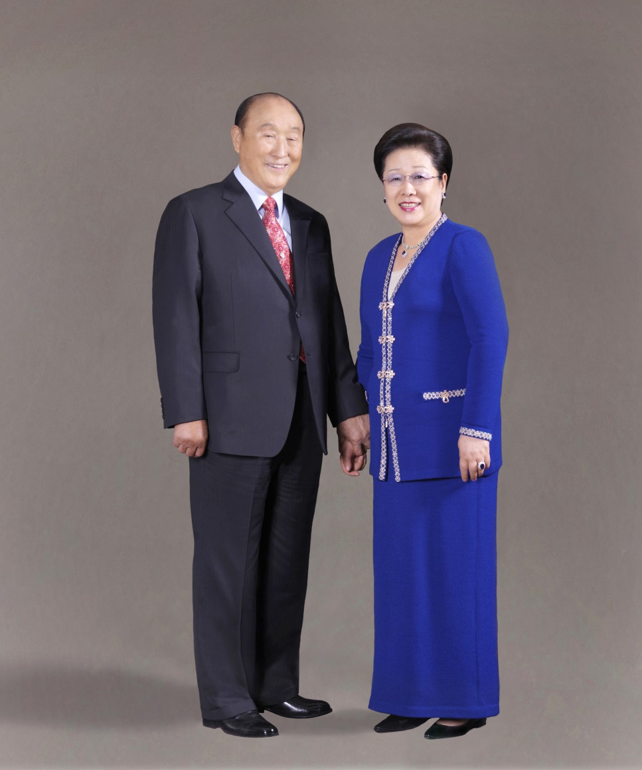
The Way of the Blessed Central Family

